Slide 1
THE state of Brazil states
Deep diving into the analysis of specific seller regions and their connection to delivery speeds, products, revenue

Slide 2
Pareto Principle
The focus should be on 20% of the seller states, generating 80% of total revenue
Delivery speed
The delivery speed of those top states must be checked. Outlier weeks should be investigated
TOP product categories
We will see which products generate most (average) revenue in those top seller states. These are our top products
PROBLEMATIC CATEGORIES
Identified high revenue product categories and have a low rating might cause future problems with client loyalty

Slide 3
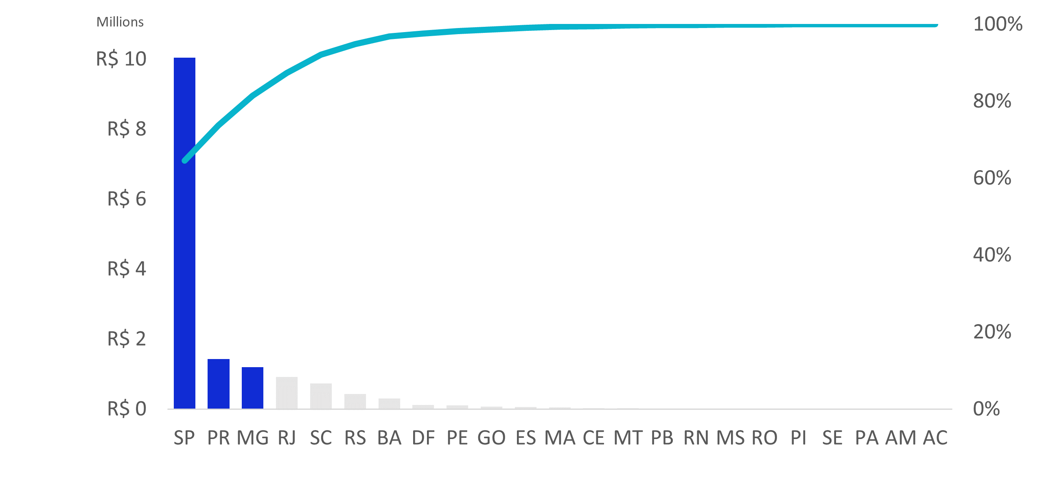
Revenue per seller state
Revenue
Total % of revenue
The focus should be on 20% states, generating 80% of total revenue. São Paulo, Paraná, and Minas Gerais generate the most. These seller states are where our interest lies

Slide 4
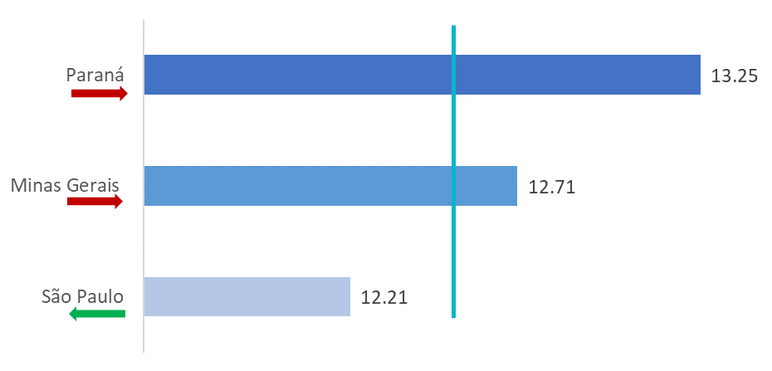
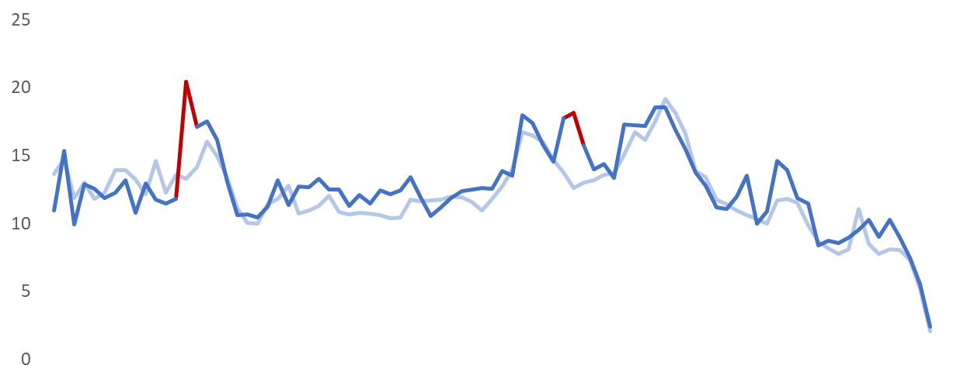
DAYS TO DELIVER
São Paulo sellers are quick to deliver. However, Minas Gerais and especially Paraná deliver products slower than on average
Average in Brazil
Days to deliver, weekly
Paraná
Compared to São Paulo, Paraná lacks behind in the beginning of April and Holiday season in 2017.
Days
São Paulo
Apr 3-9,
2017
Dec 25-31,
2017

Slide 5
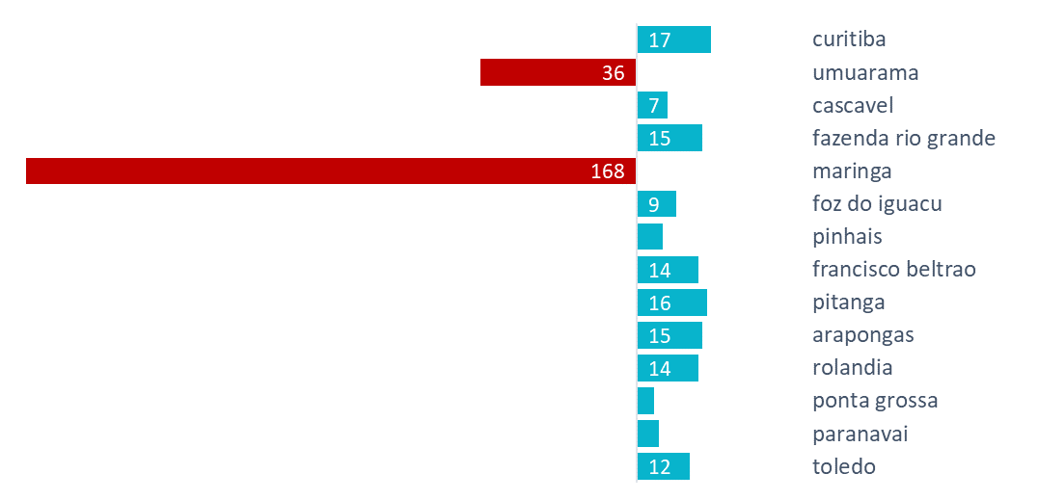
DAYS TO DELIVER, April 3-9, Paraná’s CITIES
^ Revenue
Long Maringa’s delivery is 1 order of just R$ 244

Slide 6
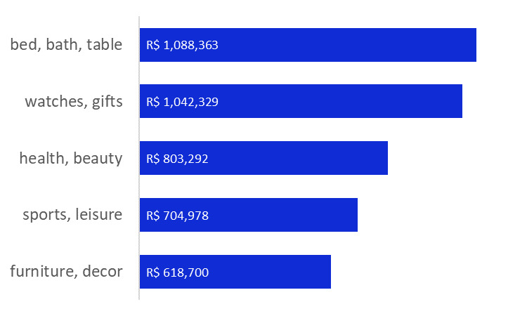
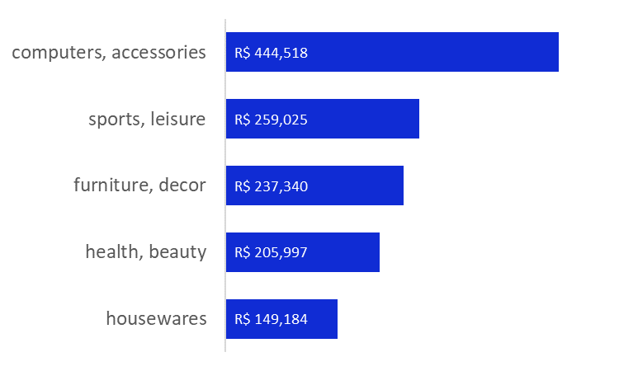
TOP PRODUCT CATEGORIES
São Paulo
Minas Gerais and Paraná
R$5,5 mill
Total Revenue
> 4
Review Score

Slide 7
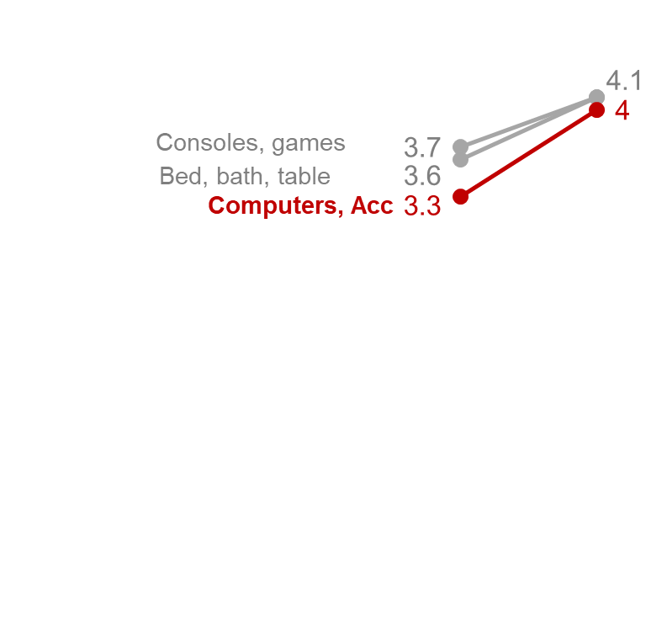

LOW RATED, BIG REVENUE PRODUCTS COMPARED TO BRAZIL
Some of Paraná’s selled products have quite a low rating, compared to Brazil. It must be investigated.
R$ 84K
Total Revenue
3.3-3.7
Review Score

Slide 8
ACTIONABLE INSIGHTS
PARETO WORKS
DELIVERY SPEED
São Paulo, Paraná, and Minas Gerais seller states generate 80% of the revenue. Our focus should be on them.
Paraná delivers products a bit slower than on average. The outlier week is an exception and should be dealt with Maringa’s managers directly.
TOP PRODUCT CATEGORIES
PROBLEMATIC CATEGORIES
Top 5 product categories in São Paulo, Paraná, and Minas Gerais are high rated and bring a lot of revenue. Use it as a perfect example.
Some of the product categories in Paraná are bringing high revenue but have a low rating. It should be investigated to prevent client loyalty problems.

Slide 9
THANK YOU

